Slide 1

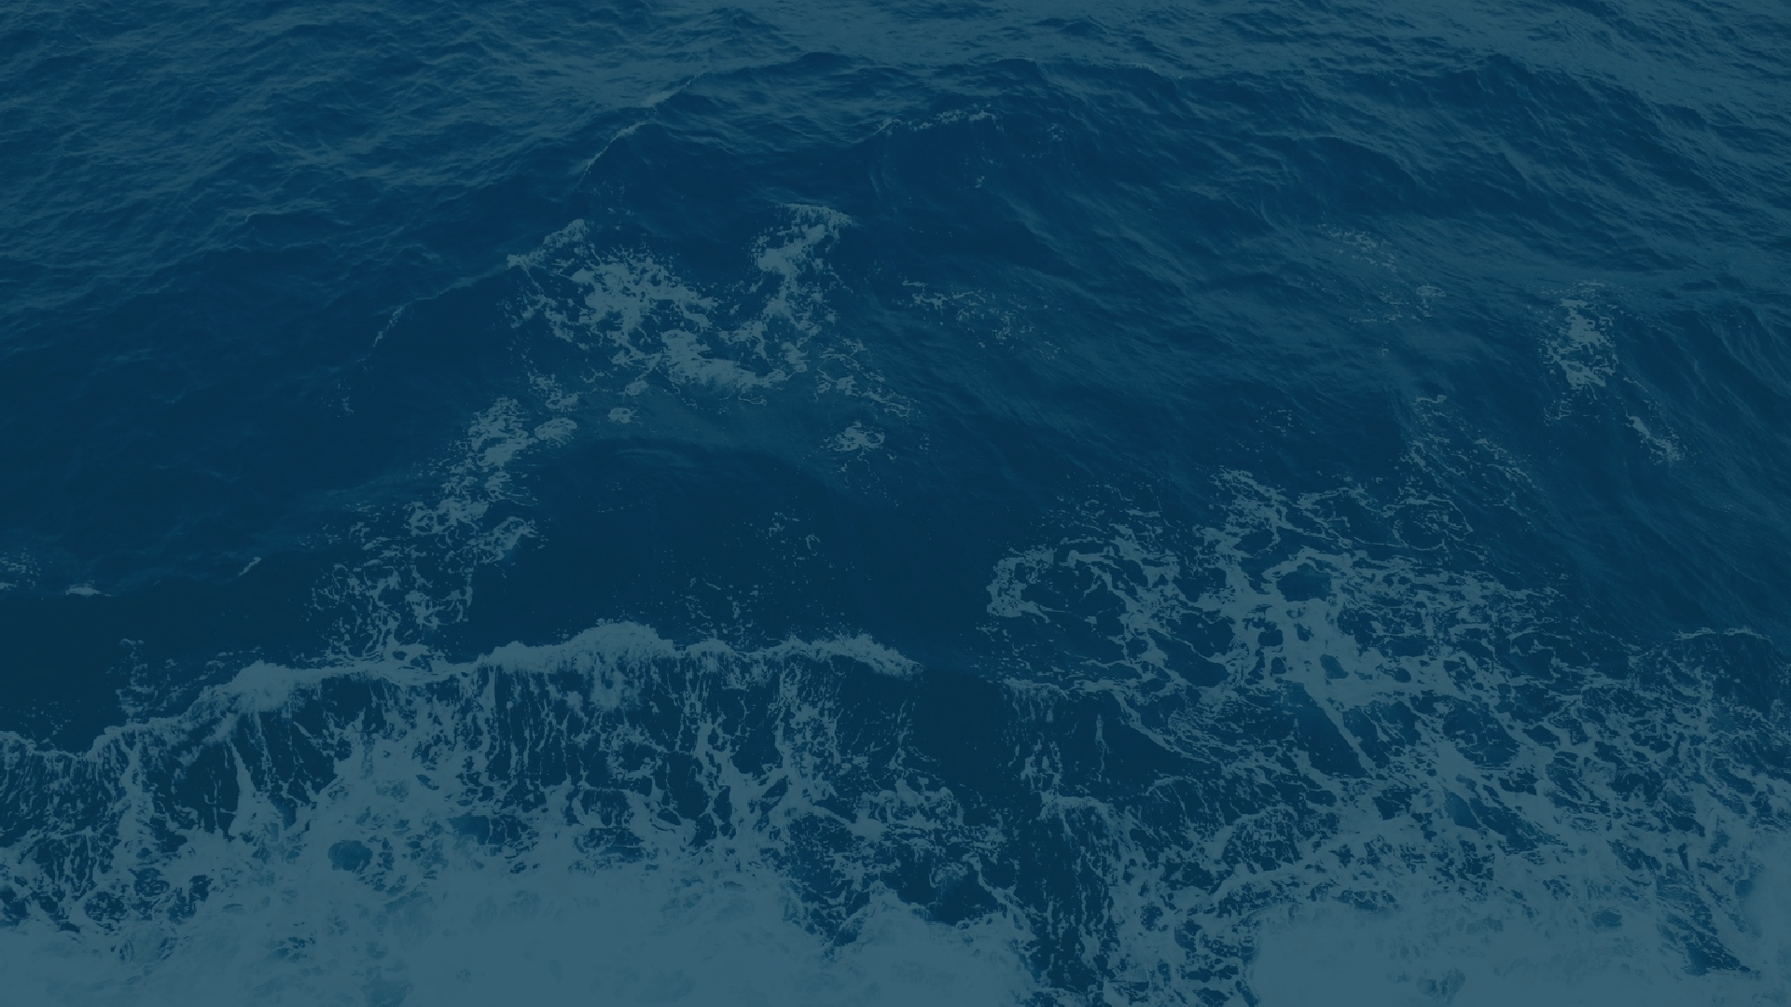
AGENTIC HACKATHON
TEAM NAME
PROJECT NAME
: WAVEATRIX
: AQUASENTINEL
TEAM MEMBERS
1 . SRI VARDHINI S R
2. S H E R I L E S T H E R V
4. SHRUTHI T K
3. S W A T H I S
PROBLEM STATEMENT
AQUASENTINEL DETECTS AND ALERTS OVERFISHING ZONE VIOLATIONS

Slide 2

INTRODUCTION TO SOLUTION
.
AquaSentinel is a zone violation alert system designed to detect and respond to unauthorized fishing activities in restricted maritime zones. The system generates multilingual audio alerts to warn fishermen when they cross into protected areas and logs each incident for monitoring and analysis. An interactive dashboard displays zone activity, violation history, and boat movement simulation. The prototype demonstrates the end-to-end workflow, while the full solution is designed to integrate with GPS modules and sensors for real-world detection and communication through mesh networks. AquaSentinel aims to support sustainable fishing practices and enhance marine zone enforcement through affordable and scalable technology.

Slide 3
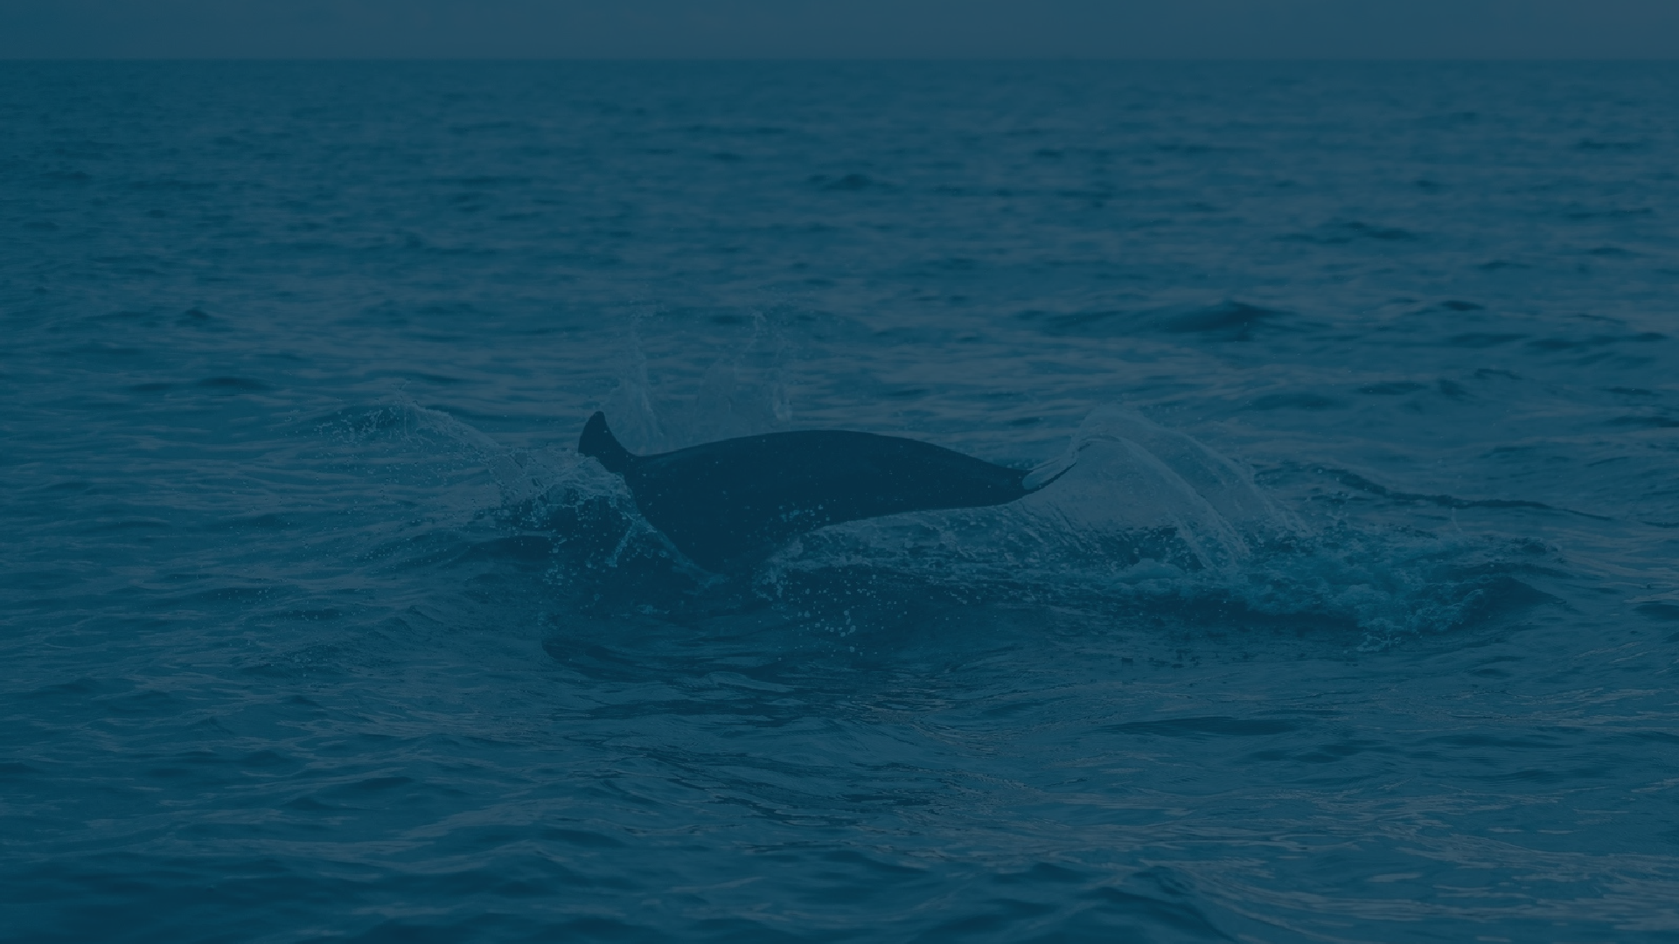
TECH STACK
A
HTML– For structuring the web dashboard Interface
CSS – For styling and responsive design
JavaScript – For client-side interactivity and simulation logic
Node.js – For running the backend server
gTTS – For generating multilingual voice alerts
MP3 Audio Files – For playing pre-generated Tamil, English, and Hindi alerts
MeshTastic – For offline mesh communication using TTGO hardware (planned)
VS Code – Code editor used for development
Replit – Onine platform for running and testing the prototype
YouTube – For hosting the demo video
Google Translate – For creating multilingual content
Tamil Input Tools – For preparing native language text content

Slide 4

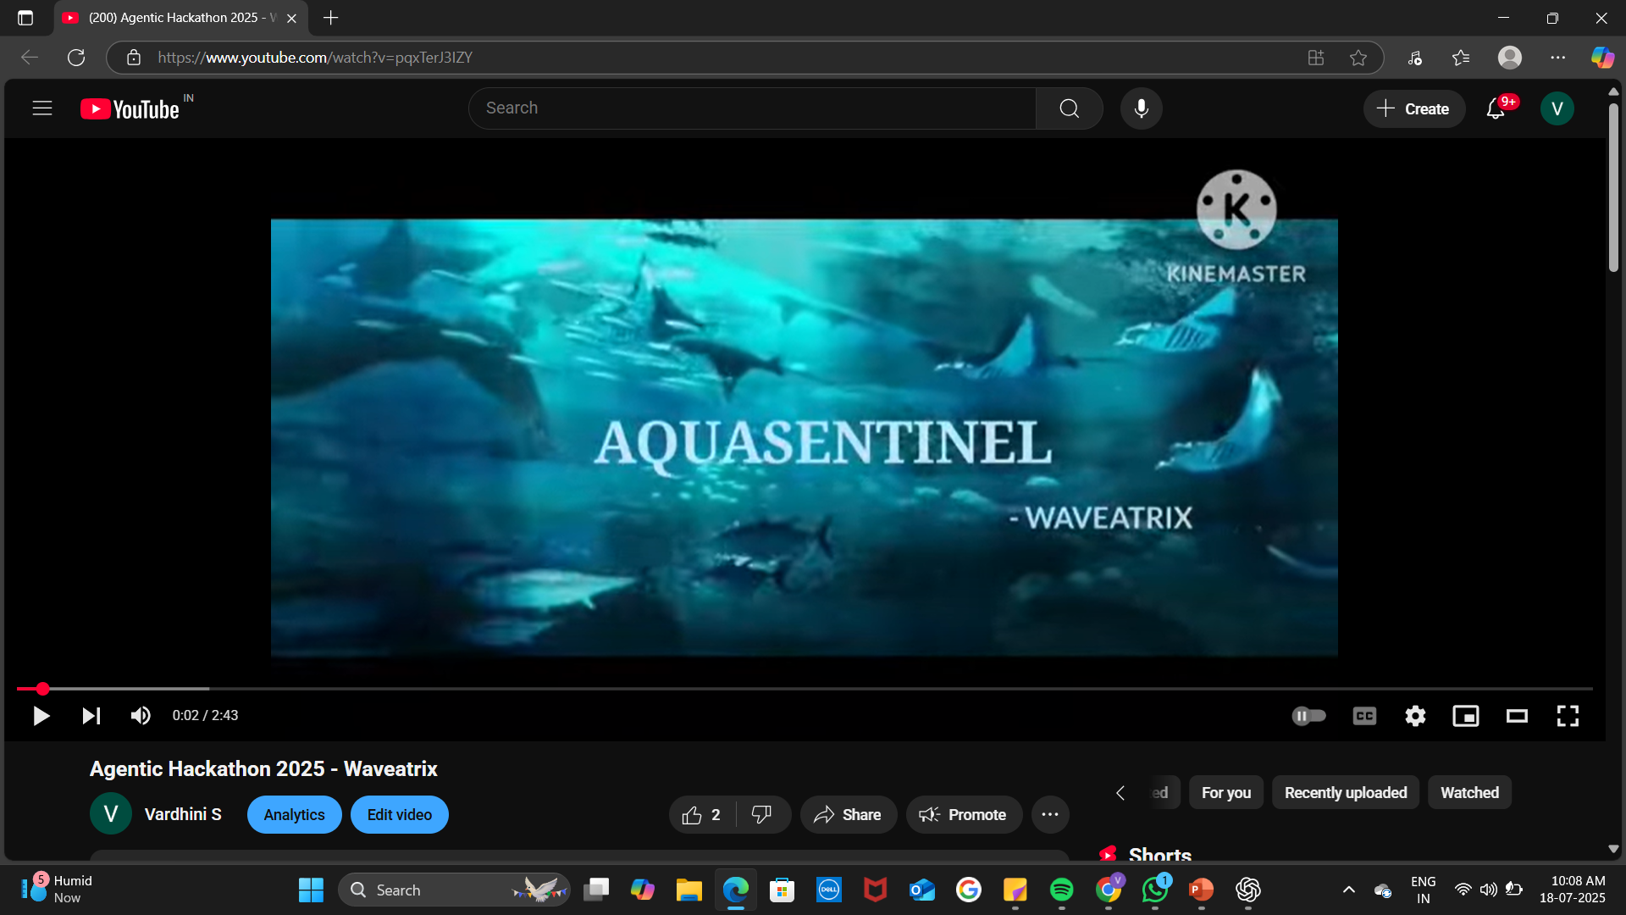
Demo: Overfishing Alert System
🗺
Demo video link : https://youtu.be/pqxTerJ3IZY

Slide 5
BUSINESS ANALYTICS
Real-world Use
Fishermen often risk their safety and livelihood without knowing they’ve crossed limits. AquaSentinel gives them real-time voice and light alerts, while helping authorities step in early to prevent overfishing.
Impact That Matters
>>Protects India’s ₹1.8 lakh crore Blue Economy
>>Supports millions of coastal families who depend on the sea
>>Helps keep our oceans alive with rich marine biodiversity
Designed to Scale
>>Works offline, perfect for remote coastal areas
>>Runs on solar power, built tough for rough seas
>>Costs under ₹3,000, making it accessible to all
>>Can be adapted for global fisheries and reserve

